Slide 1
LS 225 – 5. Object Creation Patterns
May 3, 2020

Slide 2
Assignments
Intro
Factory patterns
Practice: create objects with factory patterns
Constructor pattern
Objects and prototypes
Prototypal inheritance and behavior delegation
Practice
Function prototypes and object prototypes
Constructors, prototypes, prototype chain
Practice: constructor functions and prototypes (1, 2)
Pseudo-classical patterns + OLOO pattern
More methods on Object constructor
Doug Crockford lecture
Summary
Quiz

Slide 3
Intro
Video that shows the concepts in the assignment: http://www.objectplayground.com/
Behaviour’s not implemented using class-based inheritance, but object prototypes are used to share properties
There are different ways of generating individual objects
Two approaches to generating objects in OOP

Slide 4
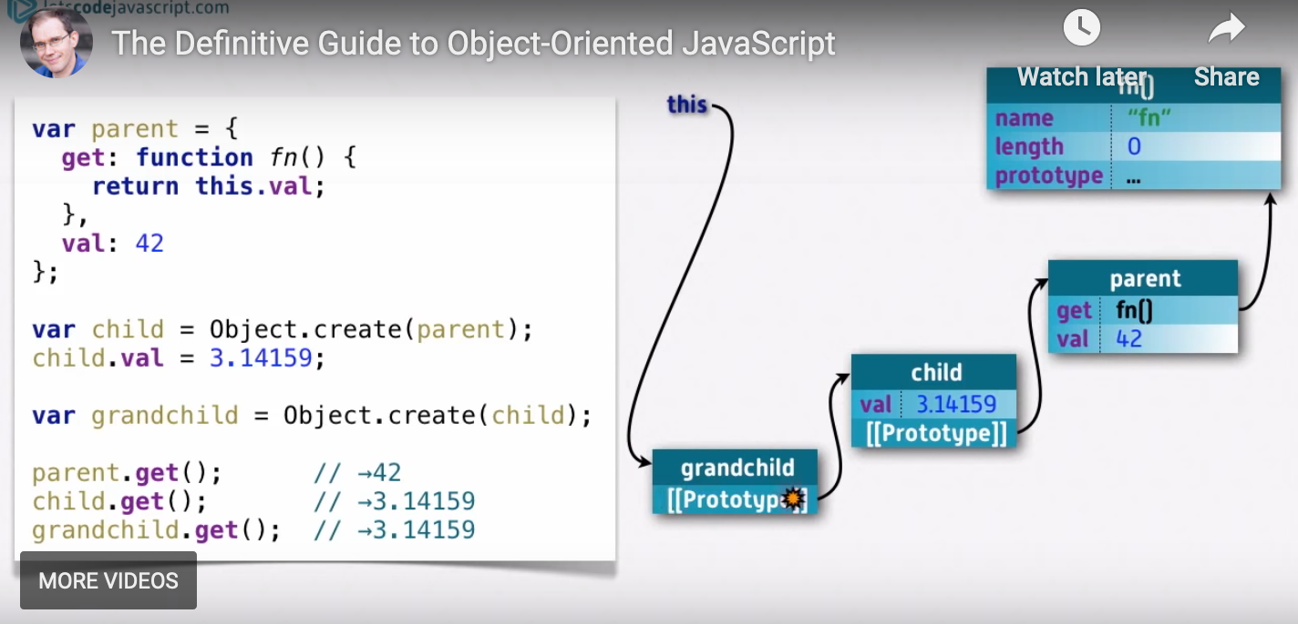
Object playground: illustration of inheritance
Illustrates how `this` works: how the called function looks for `this` when it’s called

Slide 5
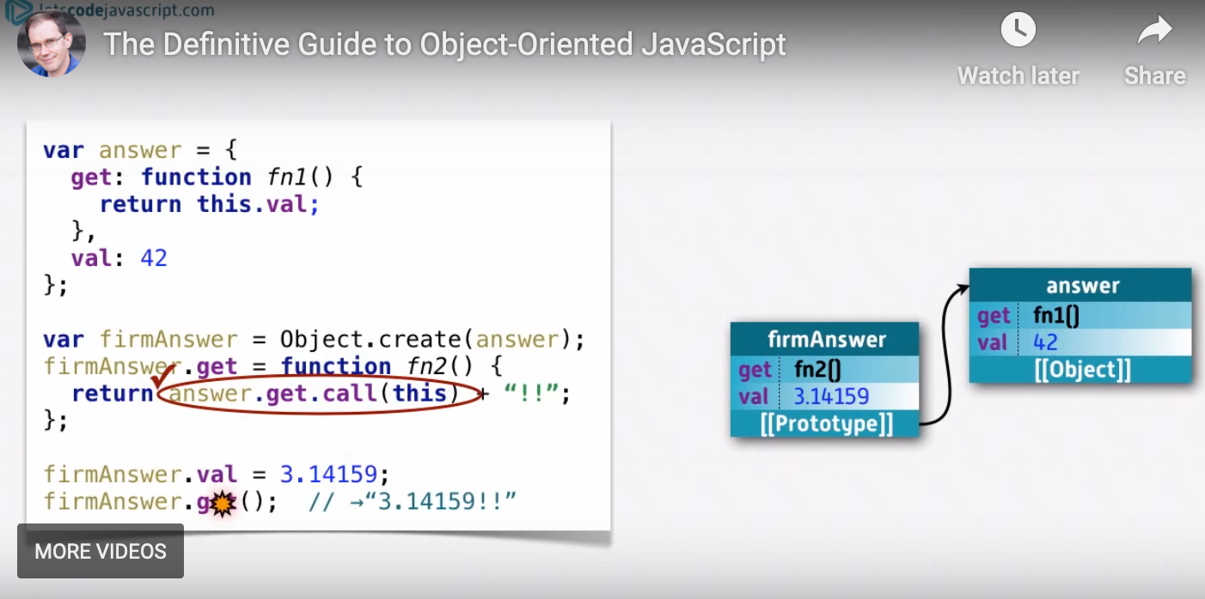
Object playground: illustration of polymorphism
This is how one can specify the object getting called
Instead of `answer.get()`, it becomes `answer.get.call(this)`

Slide 6
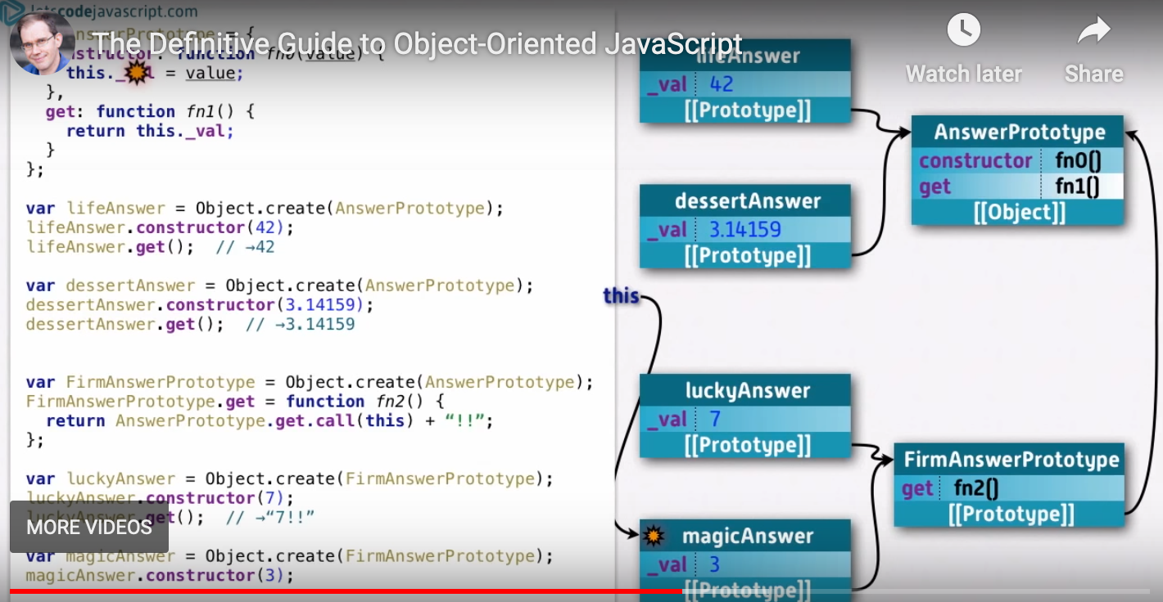
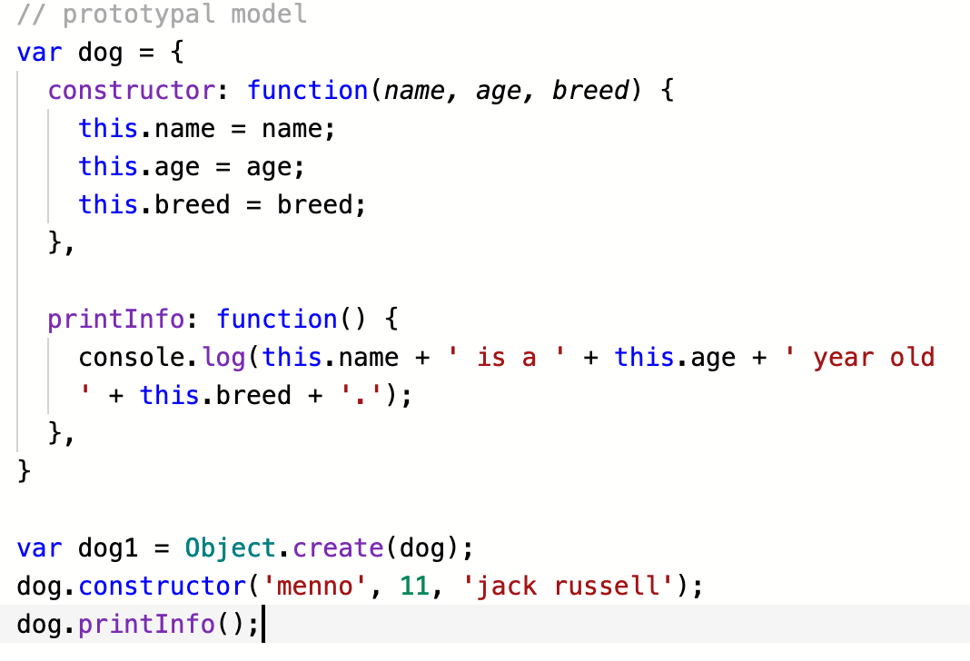
Object playground: prototypal inheritance
How to use the constructor method to hide private data and initialize it for each new instance

Slide 7
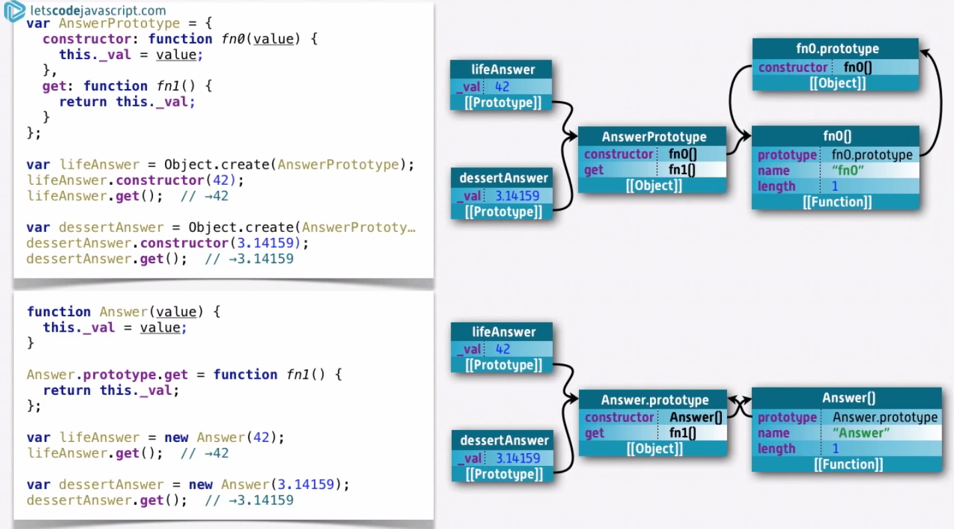
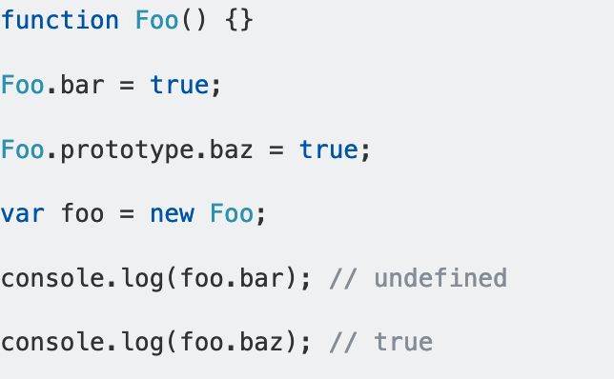
Object playground: classical model
It’s important to understand what happens when a function is created in JS
A function has three properties: name, length, and prototype
What is prototype?
It’s another object (fn.prototype) that’s separate from the current object
Its constructor points back to the current function
Every time a function is defined, a constructor is created with a do-nothing class
When we create the function Foo(), an object Foo.prototype is automatically created
We want to define new methods on the prototype and not on the function itself, so that new instances inherit the methods defined on the prototype, since methods added to the object can not be inherited

Slide 8
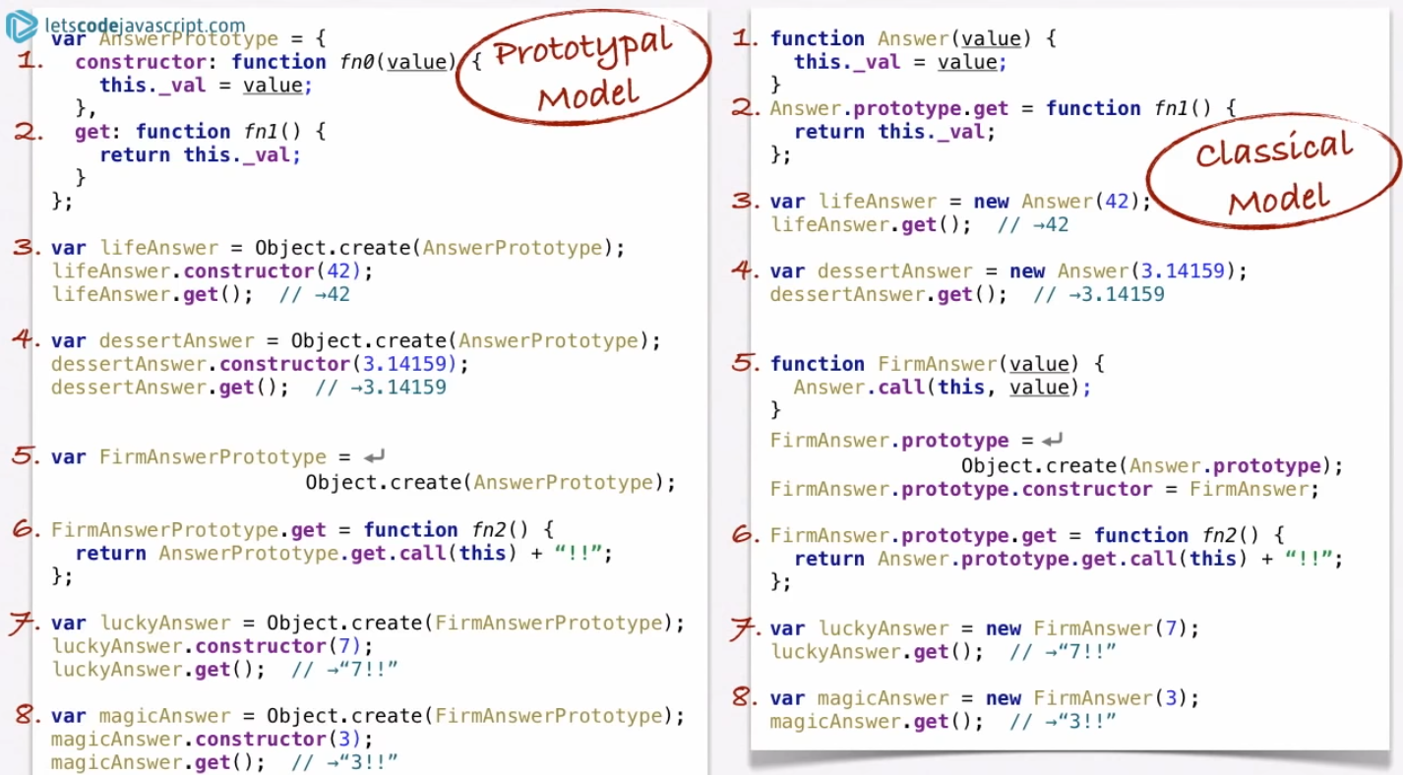
Object playground: side by side comparison of two approaches in code

Slide 9
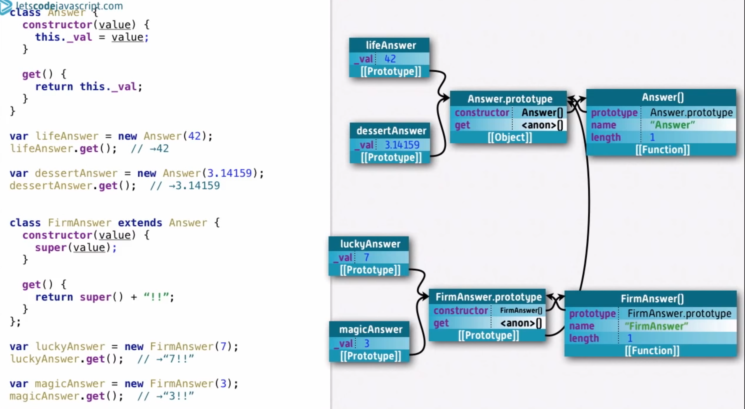
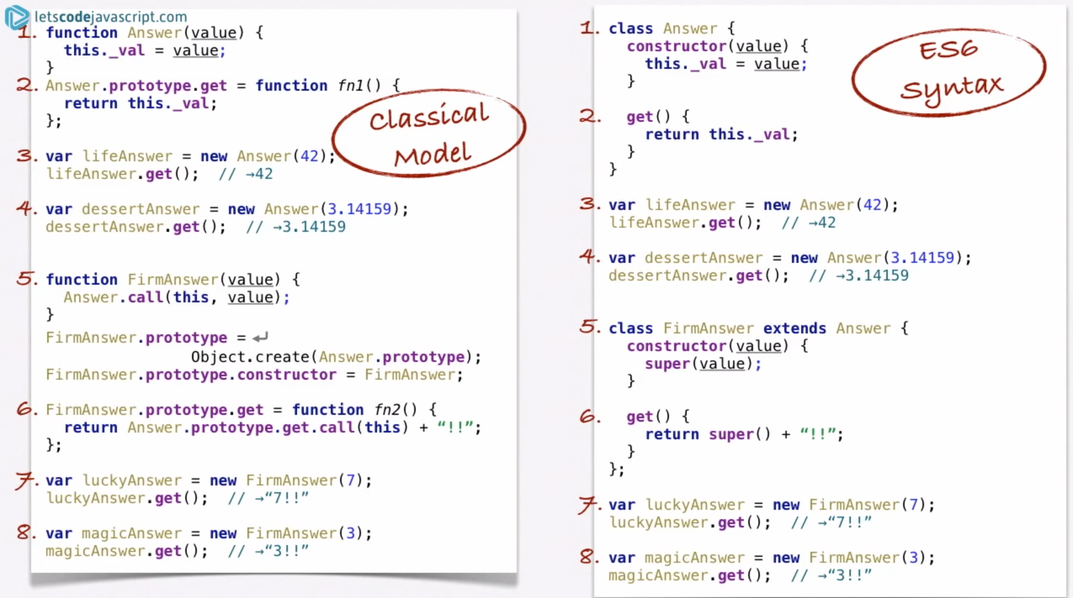
Object playground: the new class syntax

Slide 10
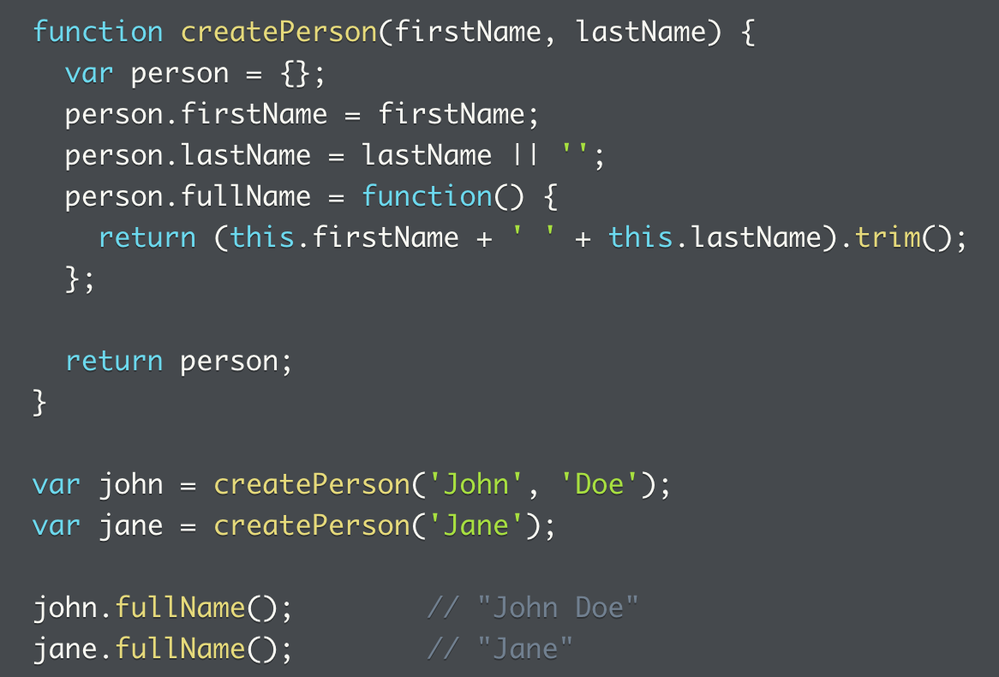
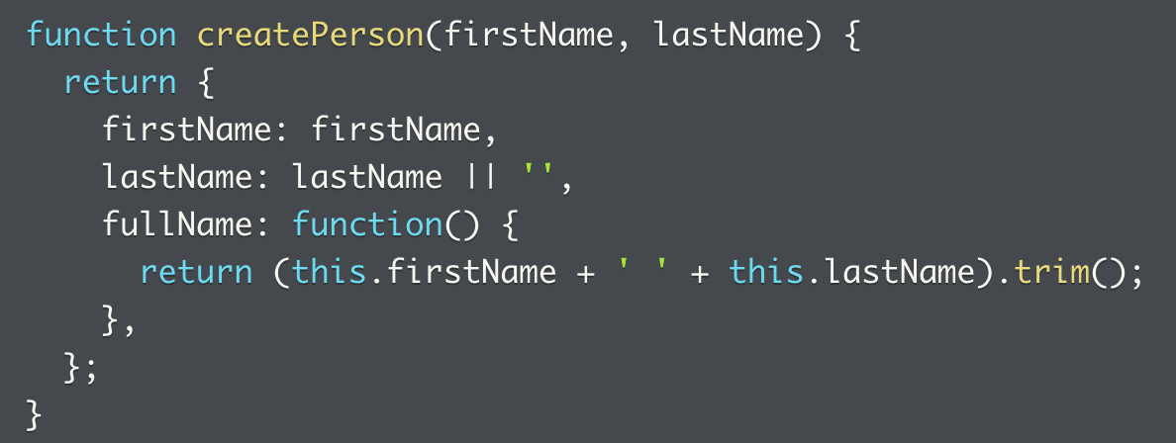
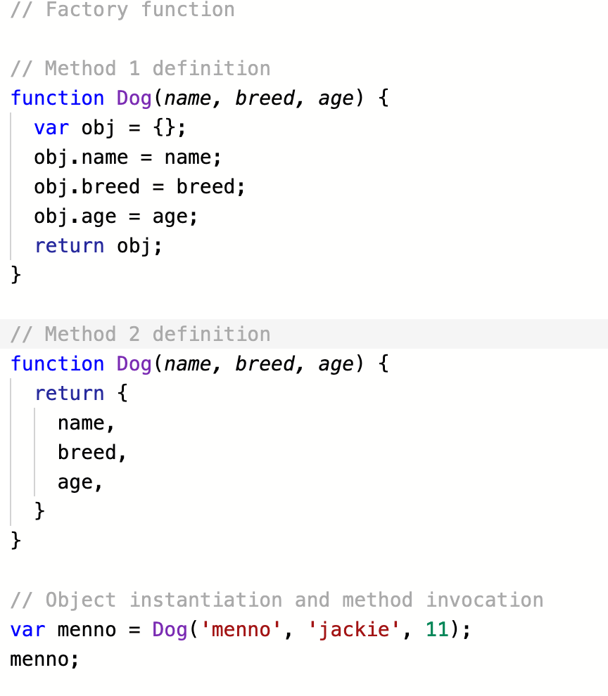
Factory functions
Allow the creation of objects based on pre-defined template
Two general ways to use this method:
1. create an object, extend properties of this object, those properties can be primitive values or a function, then return the object; a new object can then be created based on the function while passing in the necessary parameters
2. the entire function creates a return function that takes `this` object and returns properties (some of which may be functions)
Disadvantages:
Every object created with this function has a full copy of all methods, some may be unnecessary
No way to know if an object is made from a factory function, hard to identify object is a specific ‘type’

Slide 11
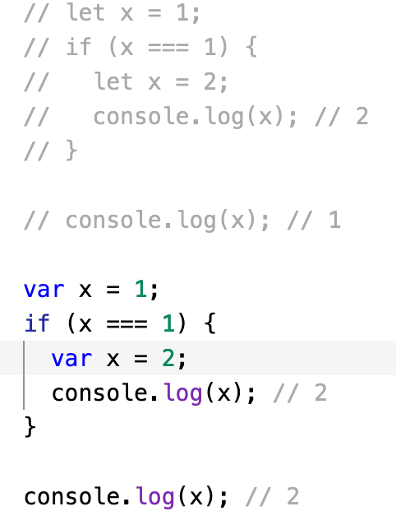
Additional notes on `let` since update
We see that the scope of the `let` variable is limited to the block where it’s initialized
The `var` variable has a scope that closes over the entire enclosing function

Slide 12
Practice: create objects with factory function
1. Disadvantages: redundant methods, no way of knowing if an object is made from a factory function
2. Turn the (above slide) method 1 into method 2, essentially having the constructor function return a whole function, using object literals instead of `=`, and not returning the object (cuz there isn’t one)
3. Write a factory function that returns an object (invoice)
Create an invoice function that takes invoice
4. Same as above, return an object (payment)
5. Allow the invoice object to also take payment, so adding more methods to the first constructor function, this time taking in two cases
Note was able to solve this with a number to track the invoice instead of an array, works just as well

Slide 13
Notes on using the factory function
In the more complicated example, we are trying to create the following app:
An invoice function where an invoice object can be created
This invoice tracks the amount of bill that needs to be paid
The invoice object has the ability to add an invoice of various properties, it also has the ability to return values of all invoices collected, amount paid, and the net amount due
The amount of invoice paid is passed through an object created through an payment function

Slide 14
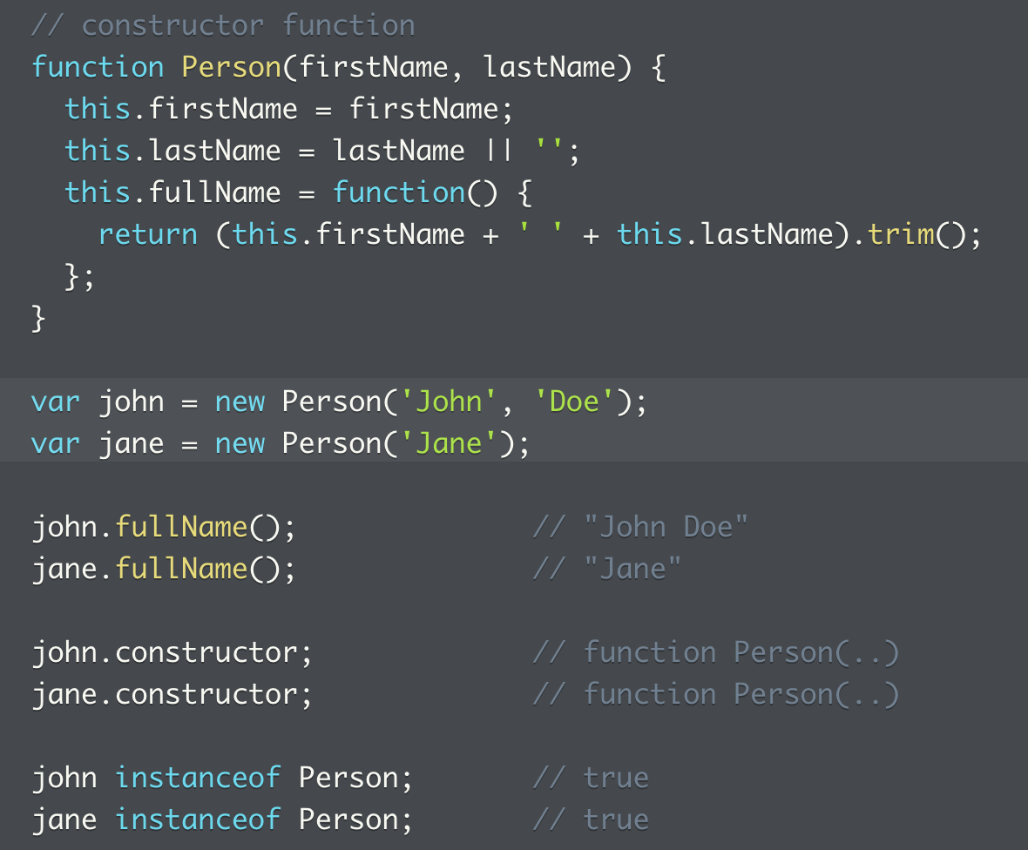
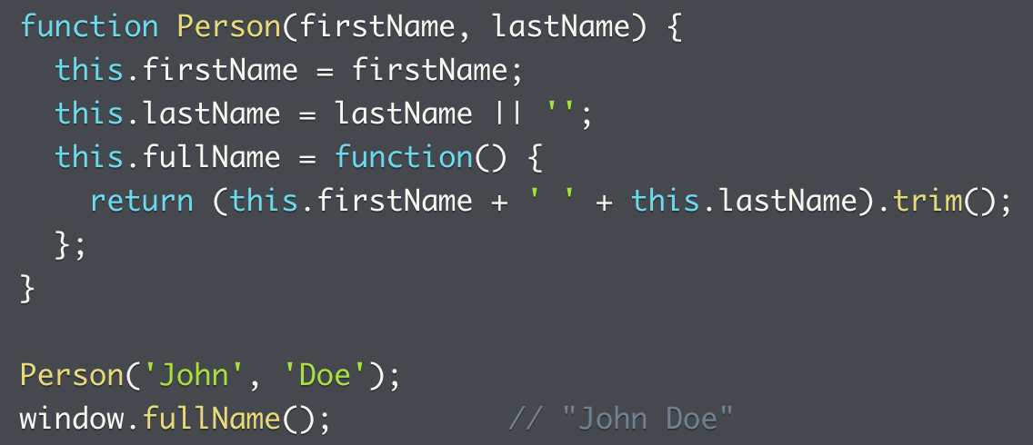
Constructor pattern
An example of the constructor pattern
The new object is called with the `new` operator
The function is meant to be called with the `new` operator
Without the `new` operator, this works quite differently
In this case, the object has global scope
And it’s not an object where `constructor()` can be called upon
What happens when the `new` operator is called?
New object created
`this` set to new object
Code in function executed
`this` returned if constructor doesn’t explicitly return object

Slide 15
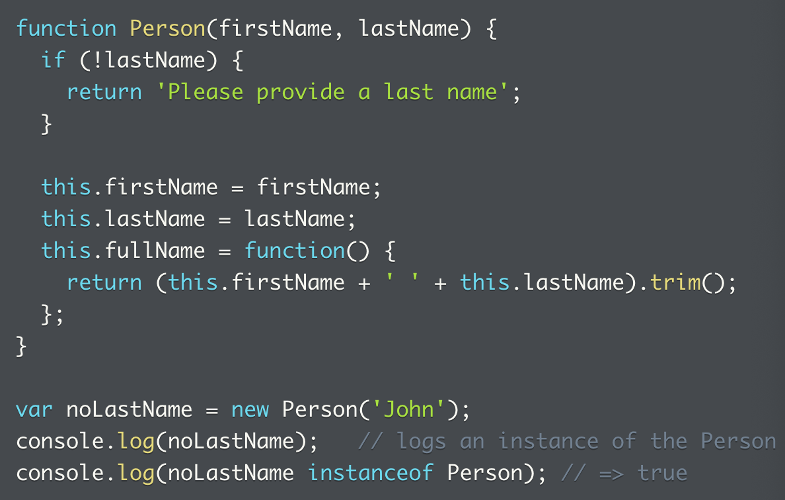
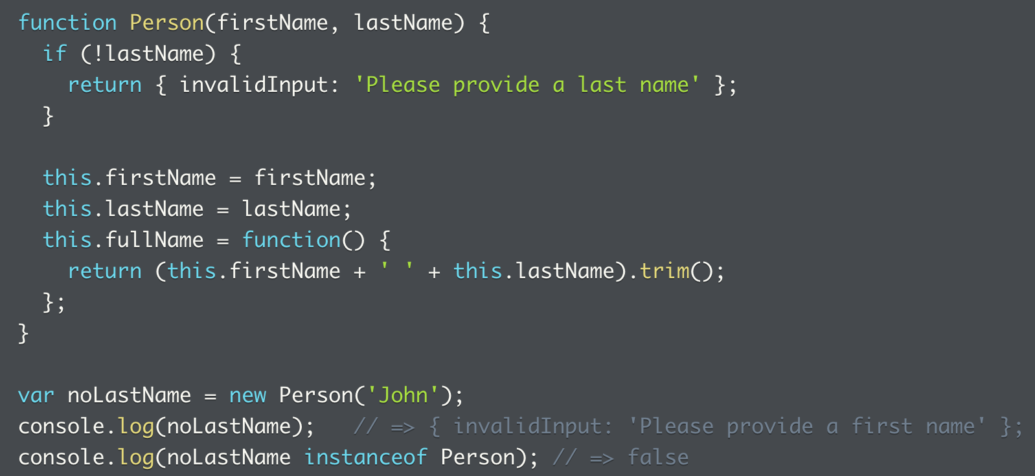
Constructor pattern -> when constructor doesn’t explicitly return an object
`this` is returned if constructor doesn’t explicitly return an object
This might results in a bug if a validation fails, and the object is still created that tests true to being an `instanceof` the constructor function
Solution: return a function instead
This is apparent later on when we construct the `neww()` method, where the return value of the function needs to be noted
A few resources to revisit:
https://launchschool.com/lessons/c9200ad2/assignments/4cc36fd6
https://web.archive.org/web/20180209163541/https://dmitripavlutin.com/gentle-explanation-of-this-in-javascript/

Slide 16
Practice: constructor functions
1. Naming convention: capitalized function names
2. When instantiating an object from a constructor function without the `new` keyword
3. Fix the above problem

Slide 17
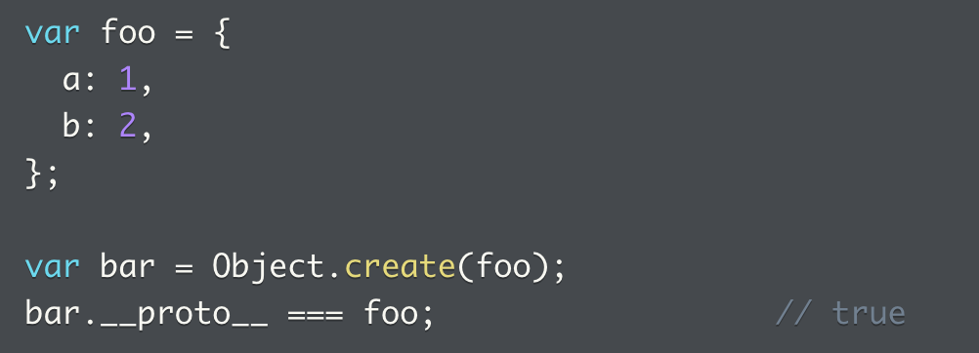
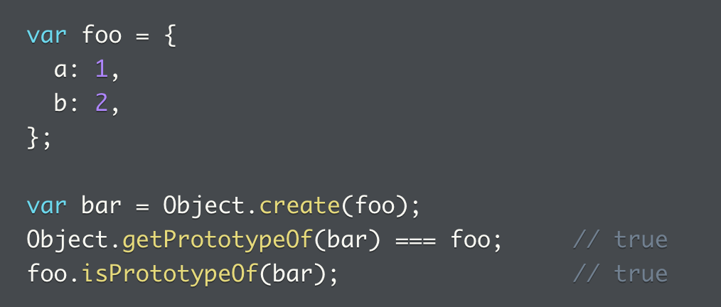
Objects and prototypes
What is `__proto__` (dunder (double underscore) proto)?
Special property for every JS object, which points to another object
When Object.create() is used to create an object, the new object set its _proto_ property to the object it’s created from
In other words, we created object `bar` with object `foo` as prototype
We created new object called bar that used foo as a template
Or, `foo` is the `prototype object` of the object returned by Object.create, and assigned to `bar`
foo is the template original product of the new object returned by Object.create and assigned to new object variable called bar
Object.getPrototypeOf(obj)
To get the prototype of `obj`
Get the template object of the newly created object
This is always the object directly above the current object in the chain, no further than that
obj.isPrototypeOf(foo)
To check if `foo` is a prototype object of `bar`
Is the object a copy of this particular template object?
Any objects up the prototype chain will return true in this case

Slide 18
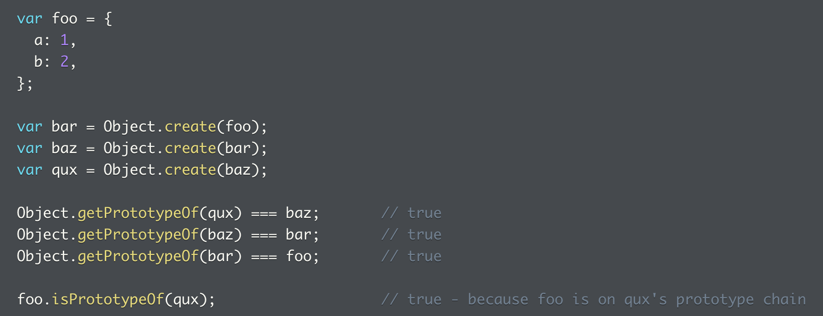
Prototype chain and Object.prototype Object
Object.create can be used to create objects that form a prototype chain
We can see the prototype of each new object is the template object where it’s made from (almost like a parent object)
Also, obj.isPrototypeOf(anotherObj) will always return true if obj rests on the prototype chain of `anotherObj`
What’s at the end of the prototype chain?
Object.prototype
If object is not created from a prototype, its prototype is the `Object.prototype` object

Slide 19
Prototype chain: problems
1. How to assign a new variable name to a new object with an object as its prototype.
2. How to demonstrate relationship between prototype and newly created object.
3. How to use the Boolean method to demonstrate the relationship between prototype and newly created object.
4. Check all the way up the prototype chain.

Slide 20
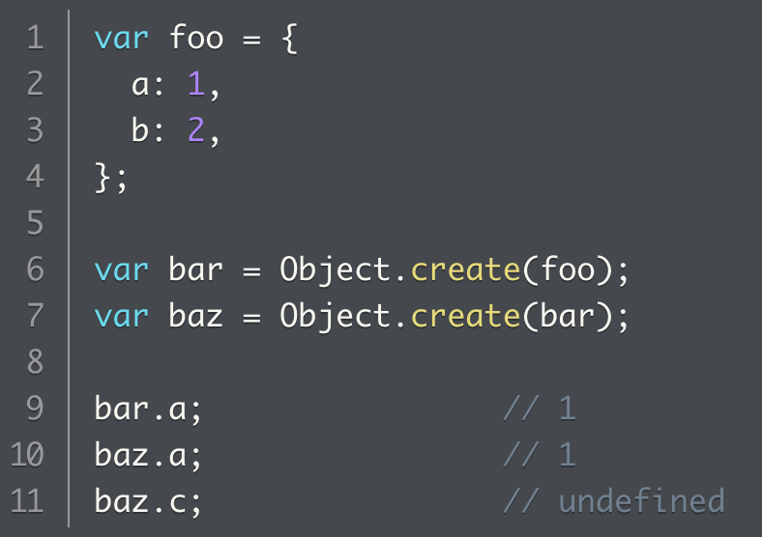
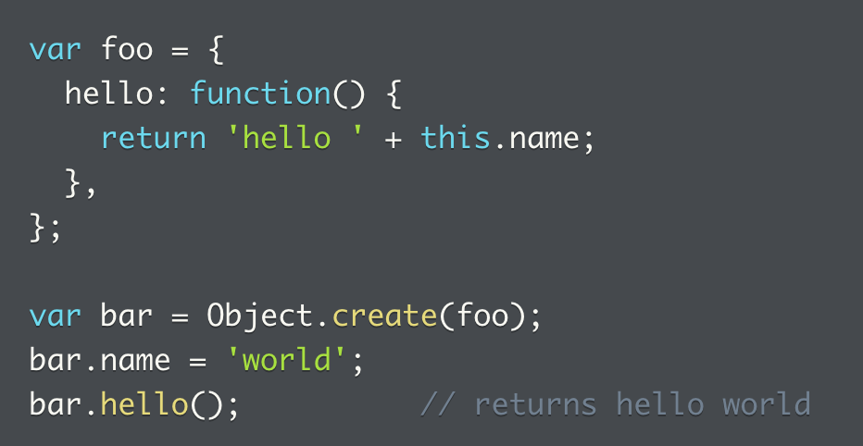
Prototypal Inheritance and Behavior Delegation
When accessing property or method on object, JS will search all the way up the prototype chain
Ex 2: `hello` method is found on `bar` object’s prototype object, called with context of `bar` object itself

Slide 21
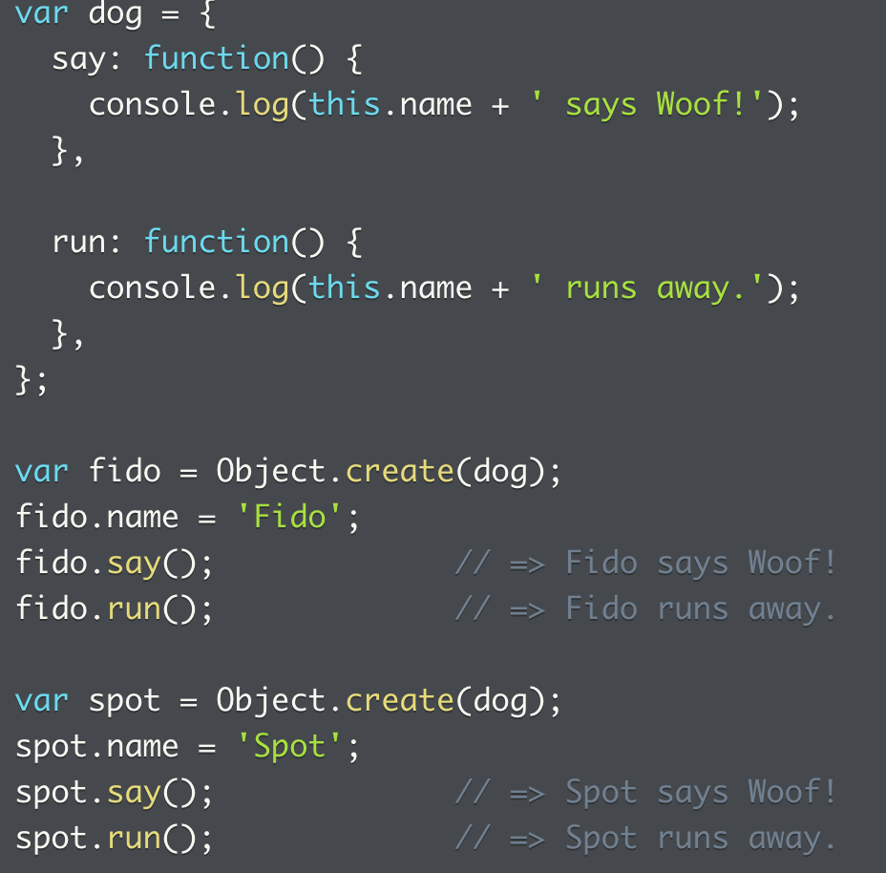
Prototypal inheritance & behavior delegation
Prototype chain lookup for properties => can store object’s data and behavior not just in object itself, but anywhere on prototype chain
Instead of defining `say` and `run` methods on every object, we define those on `dog`, the prototype object of all dogs
Dogs can be created more easily with the prototype, no need to duplicate methods on every single object
If need to add/remove/update behavior to apply to all dogs, can just modify prototype object, all dogs will pick up automatically

Slide 22
Prototypal inheritance
Inheritance => comes from OOP, where classes are used to create objects with carefully designed hierarchy for the purpose of behavior sharing
JS is more pure OO, where objects can be created directly from other objects, behaviours shared via prototype chain
Behaviour delegation
Top down design view: objects on bottom of prototype chain inherited properties and behaviours of upstream objects on prototype chain
Bottom up/run time point of view: objects on bottom of prototype chain can delegate requests to upstream objects

Slide 23
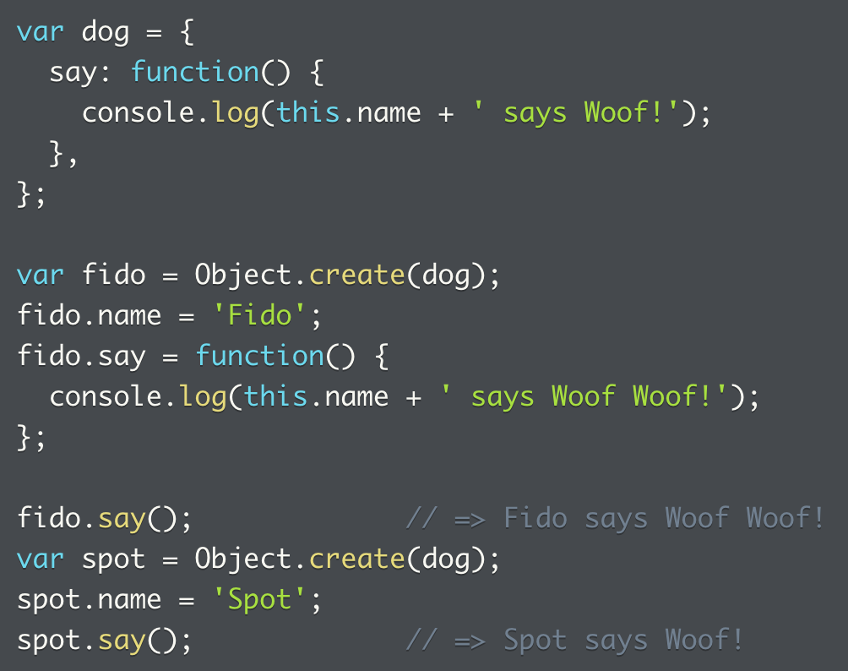
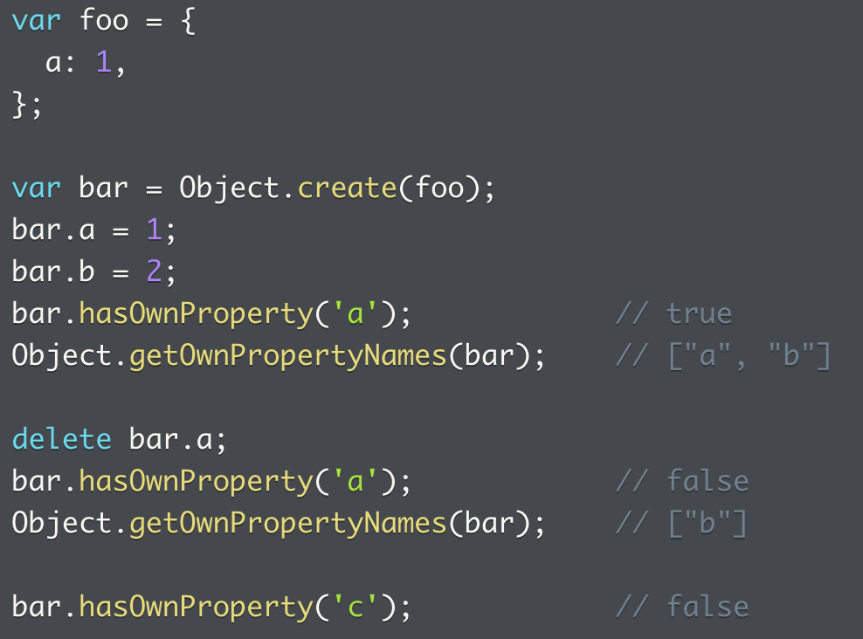
Overriding default behaviour
By defining the same methods locally, objects lower down the prototype chain can override shared behaviours
Object.getOwnPropertyNames
Returns array of object’s own property names
obj.hasOwnProperty(‘propName’)
Tests if a property is defined on the object itself

Slide 24
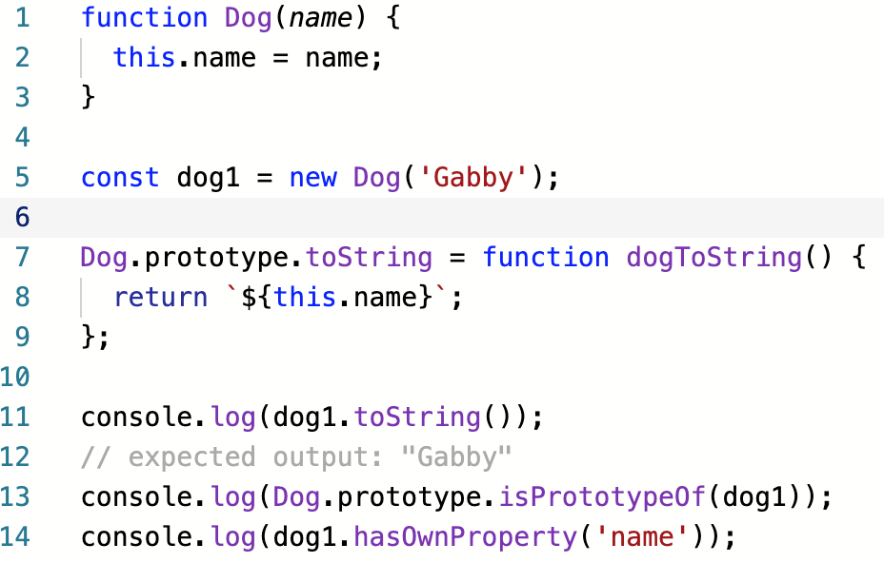
Prototypal inheritance
Three more useful methods defined on Object.prorotype (which sits atop all other JS objects)
obj.toString() => string rep of object
obj.isPrototypeOf(obj) => is object is in another object’s prototype chain
obj.hasOwnProperty(‘prop’) => if property is defined on the object itself, syntax is `obj.hasOwnProperty(‘prop’)`
Object.getPrototypeOf(obj)
More Object methods here: https://developer.mozilla.org/en-US/docs/Web/JavaScript/Reference/Global_Objects/Object

Slide 25
Problems: Object prototypes
1. How prototypal inheritance of behaviours is moved down the chain.
2. Reassignment of behaviours down the prototype chain
3. How to check what an object is delegating a behavior to? Check if the behavior belongs to the object itself or is inherited from up the chain.

Slide 26
Practice probs: prototypes/prototypal inheritance
1. Traversing up the prototype chain, the use of method to see if the object has its own property, and to get the prototype of an object
2. Construct shallow copy of object, with same prototype chain, same own properties and returns same values when accessed. Note my solution was actually more of a deep copy, where it copies all the properties up the prototype chain.
Interesting that Object.create(Object.getPrototypeOf(obj)) will basically copy the prototype object
Then we add the properties that can be identified by the object iself: obj.hasOwnProperty()
3. Making an extend function – can make it by returning a new object, or use the object passed in. Arguments are the extras it seems. Also, note that two [][] next to each other doesn’t seem to work. Also note that because the first argument is a {} and has no hash, using forEach didn’t work, so has to stick to a loop
But if use Array.prototype.slice.call(arguments), we can turn `arguments` into an array

Slide 27
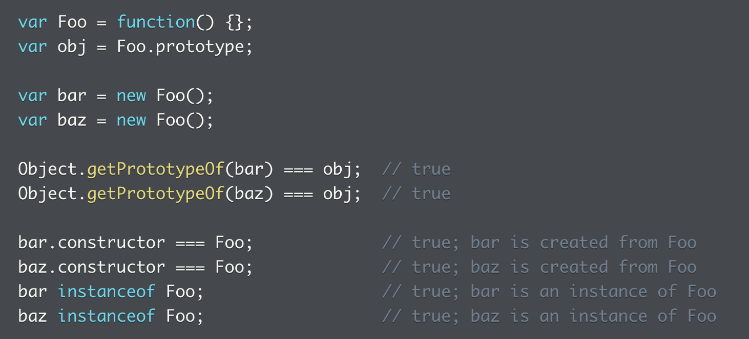
Function Prototypes and Object Prototypes
Although sounding alike, these are two different concepts
Function prototypes: property of functions
Object prototypes: the lookup for property access
In JS, every function has a special `prototype` property
Assigned by default an object that instances of constructor function can delegate to
This `prototype` property is only useful when use function as constructor
All objects it constructs will have this object set as prototype
A few functions to remember
obj = Foo.prototype;
Object.getPrototypeOf(bar) === obj;
bar.constructor === Foo;
bar instanceOf Foo;

Slide 28
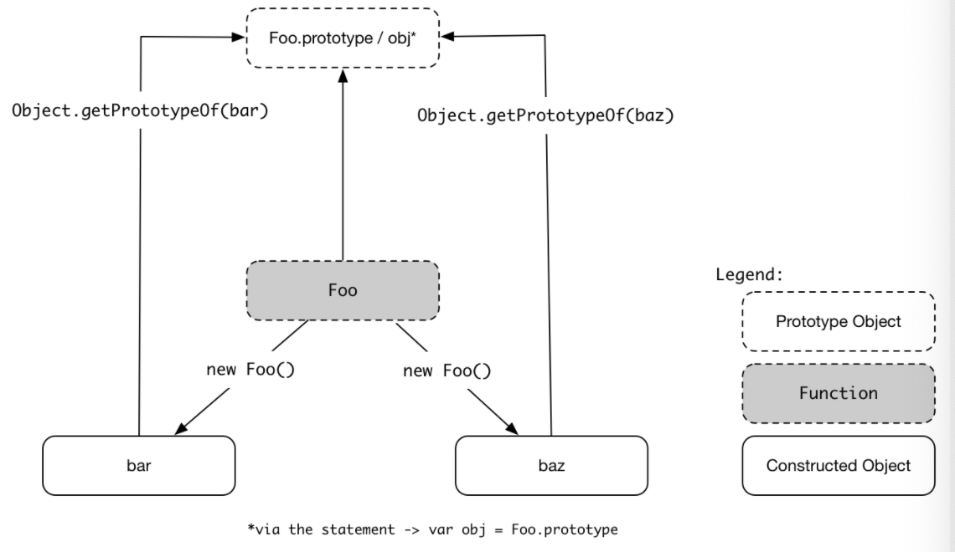
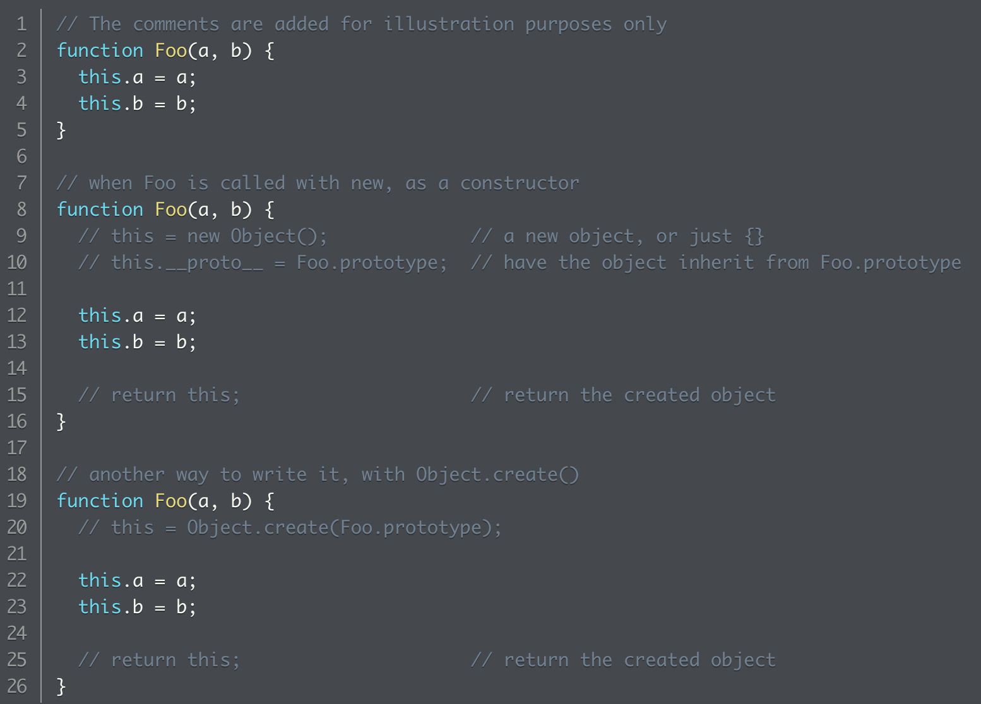
Function Prototypes and Object Prototypes 2
Set visually, both objects we construct from delegates to, or have prototype object set to – object assigned to `prototype` property of `Foo`
What happens when a constructor function is called?
Two ways as shown on the right
The first one explicitly creates a new object, and then set its _proto_ property to the prototype of the function, returns this
The second one creates the object directly using the `create` function, and also returns the object

Slide 29
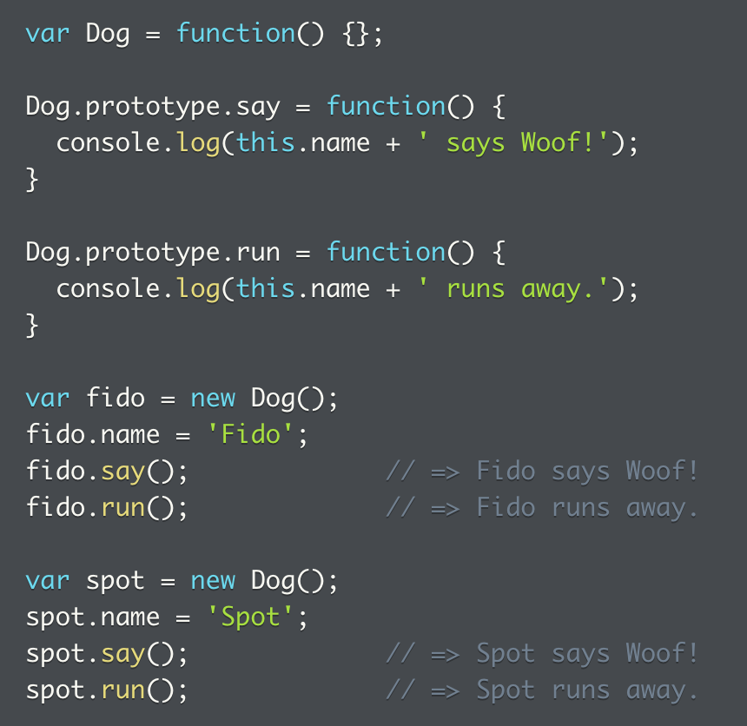
Function Prototypes and Object Prototypes 3
When function is called as a constructor, JS creates objects that are prototype linked to the object assigned to the `prototype` property
Use constructor function and `prototype` property to set up behavior delegation
Defining shared behavior on constructor’s prototype property is called `prototype pattern` of object creation

Slide 30
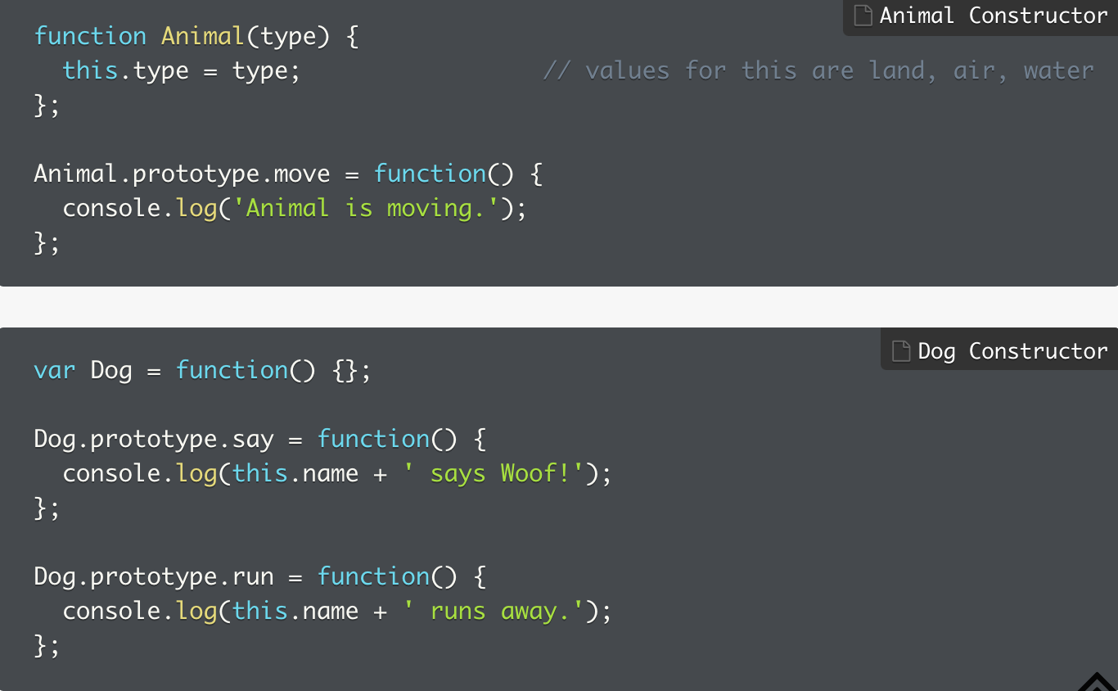
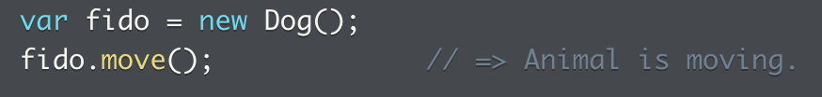
Constructors, Prototypes, and the Prototype Chain
How do you extend the prototype chain?
Objects created from Dog constructor will inherit behaviours from `Animal.prototype`
All objects created from Dog constructor will have move behavior available once we establish the prototype chain?
How do you establish the prototype chain?

Slide 31
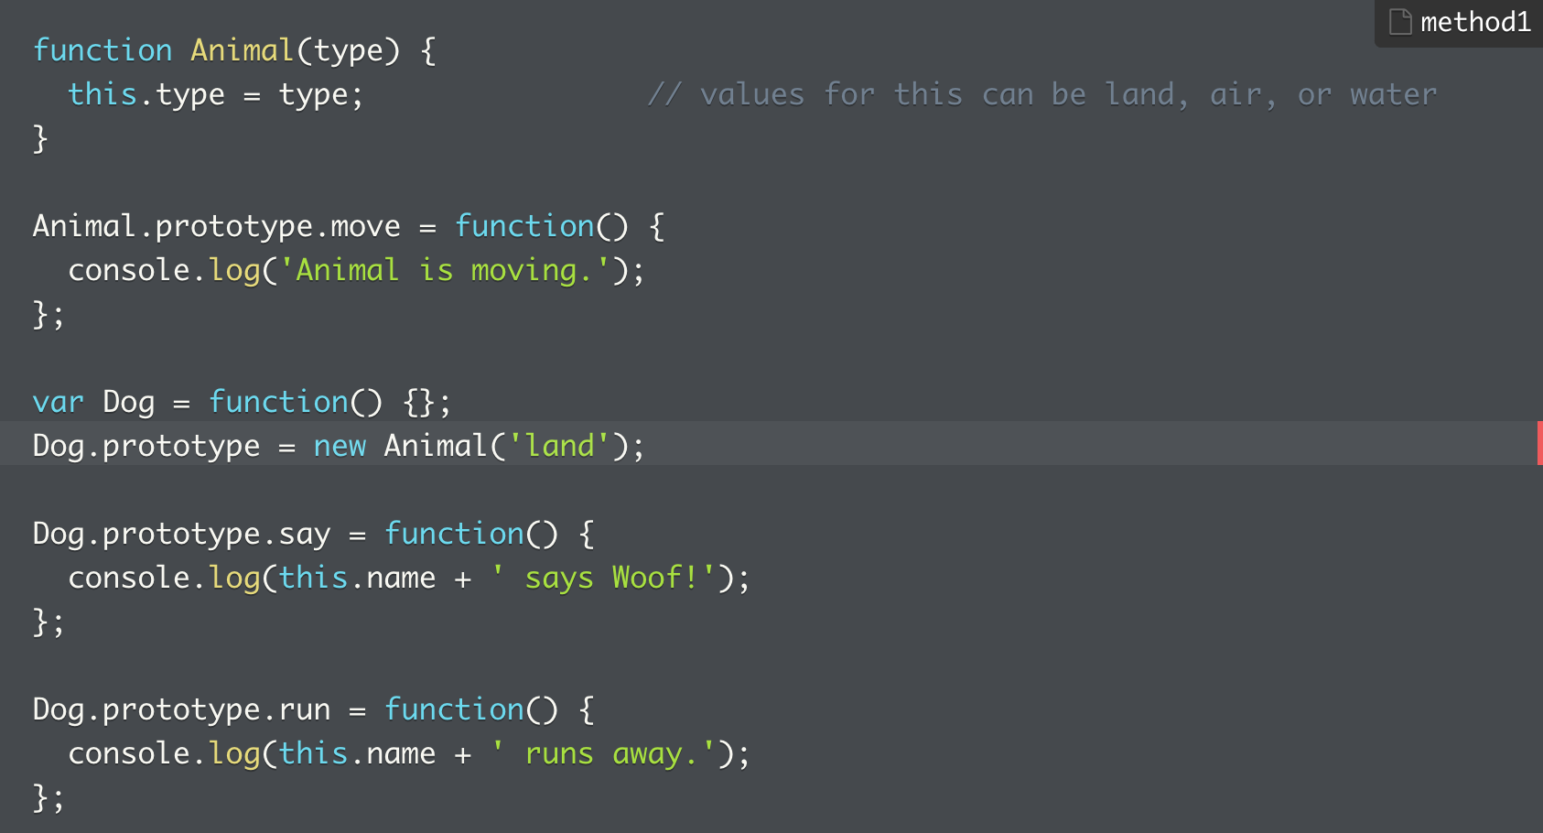

Establishing the prototypal chain 1
Method 1: use object returned by Animal constructor
Uses object Animal constructor returns as the value assigned to Dog.prototype
Any object created from Dog constructor will have properties of object returned from Animal constructor
Problem:
Deviates from idea that only behavior is shared through the prototype chain
Users of Dog constructor aren’t aware of existence of `type` property on objects created with `Dog`
It’s unexpected that a property not explicitly set has a value
Given usually only methods are delegated, this can be unexpected

Slide 32
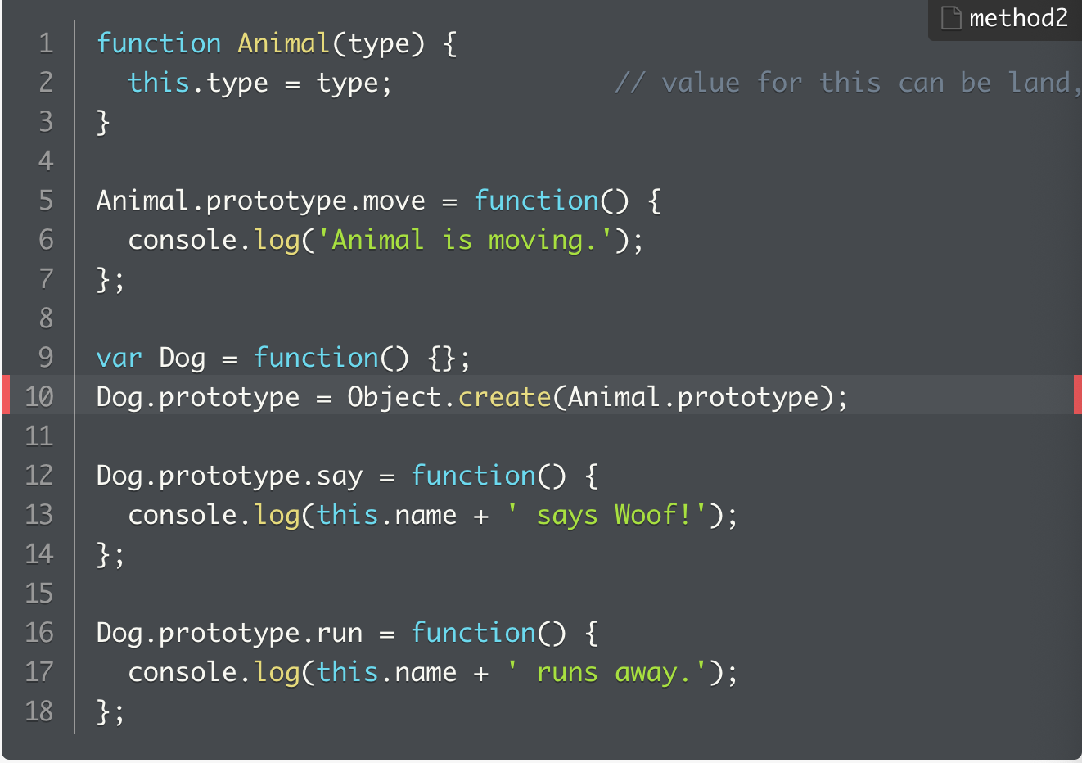
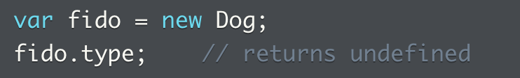
Establishing the prototypal chain 2
Using the Object created by Object.create (Animal.prototype) and assign object returned to the Dog prototype
Leverages that objects that Object.create returns have their __proto__ property set to object passed in as argument
Advantage:
No new properties can be found on created object, it’s only behavior that’s shared

Slide 33
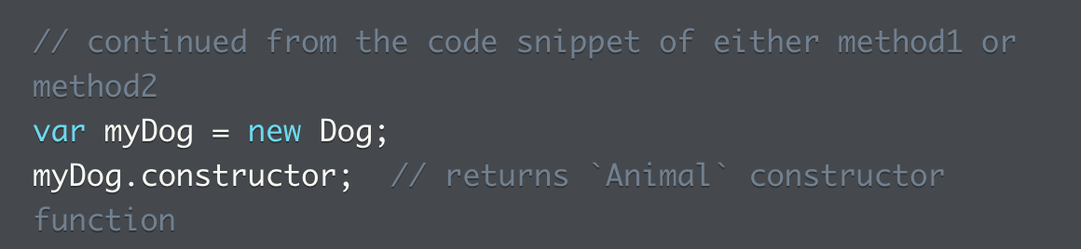
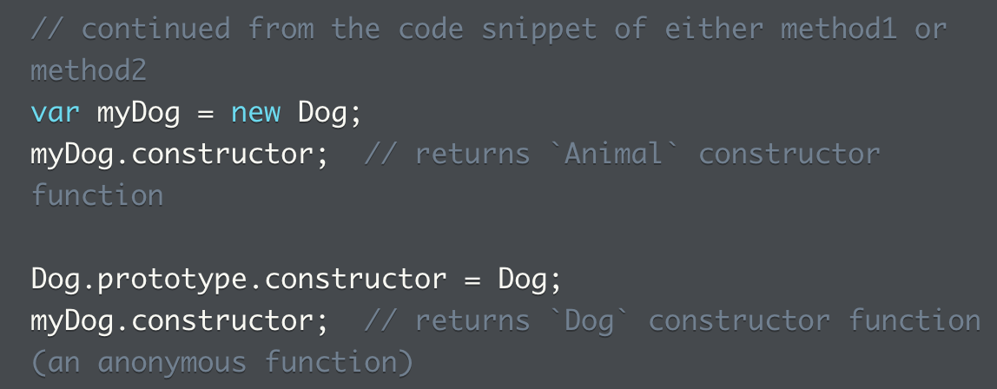
Prototypal inheritance
Both methods replace original Dog.prototype (with original constructor property referencing the Dog constructor function)
Dog.prototype.constructor now points to Animal instead
To correct this, need to reassign the Dog constructor back to dog

Slide 34
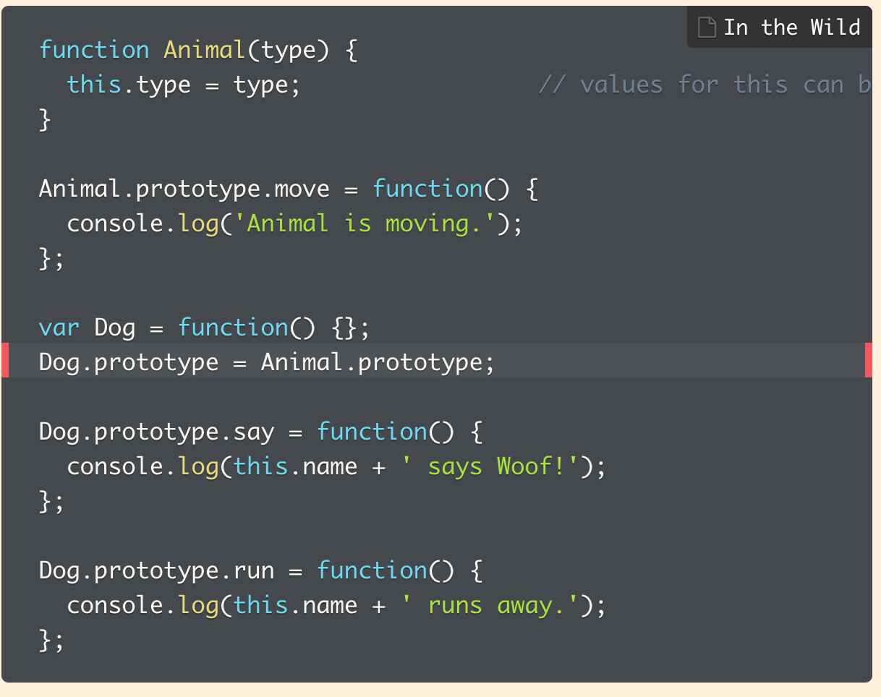
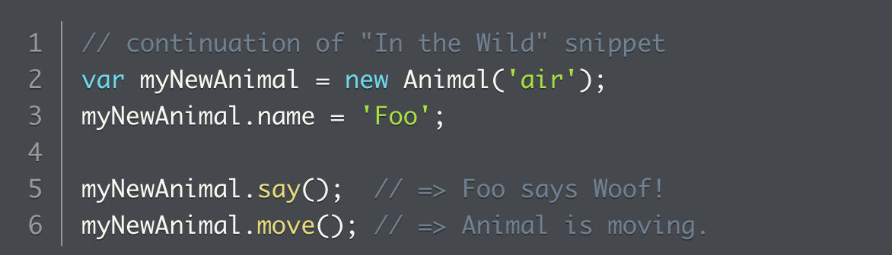
More example of prototypal inheritance
Assigning Animal.prototype to Dog.prototype leads to inherited behavior with objects created from the Dog constructor
But, additional behaviours added to Dog.prototype also becomes available to objects created from the Animal constructor
Because Dog.prototype points to the same object assigned to Animal.prototype
When Dog.prototype is mutated, change is reflected in Animal.prototype

Slide 35
Practice: constructor + prototypes 1
*1. What a constructor function and objects constructed from it can log. Global variables can be changed when a constructor is called with the same variable name. These changes get carried over.
2. How to fix a function that takes uses another object for calculation, and pass along the proper parameters.
3. Writing a constructor function given the calling function.
Note I write a straight-up constructor function
By the official guide seems to have written first an object taking in the parameter first, and then the method
4. Prototype chain
5. The difference between adding a new method to a prototype chain versus pointing the prototype to a different object
6. With chainable methods, how to return the context object
7. How to create a new object using the prototype of another already-made object’s prototype object

Slide 36
Practice 2: Constructor functions and prototypes
1. not sure why the constructor had to be reset back to the Triangle at the end, everything worked even when the prototype was set at shape
Also, what’s the advantage of writing out the getPerimeter() method separately, why not just leave the methods in the constructor function? Below my solution also works

Slide 37
Questions from elsewhere
6 kyu Cylon Evolution (codewars), on object prototype creation

Slide 38
The Pseudo-classical Pattern and the OLOO Pattern
Pseudo-classical pattern
OLOO (object linking to other object)
What are the issues to consider when creating objects?
Object literals work if we only need one object
If more points are needed, points need to:
Have own states, represented by x and y values
Share distanceToOrigin, onXAxis, onYAxis behaviours, work the same way for all points on coordinate plane

Slide 39
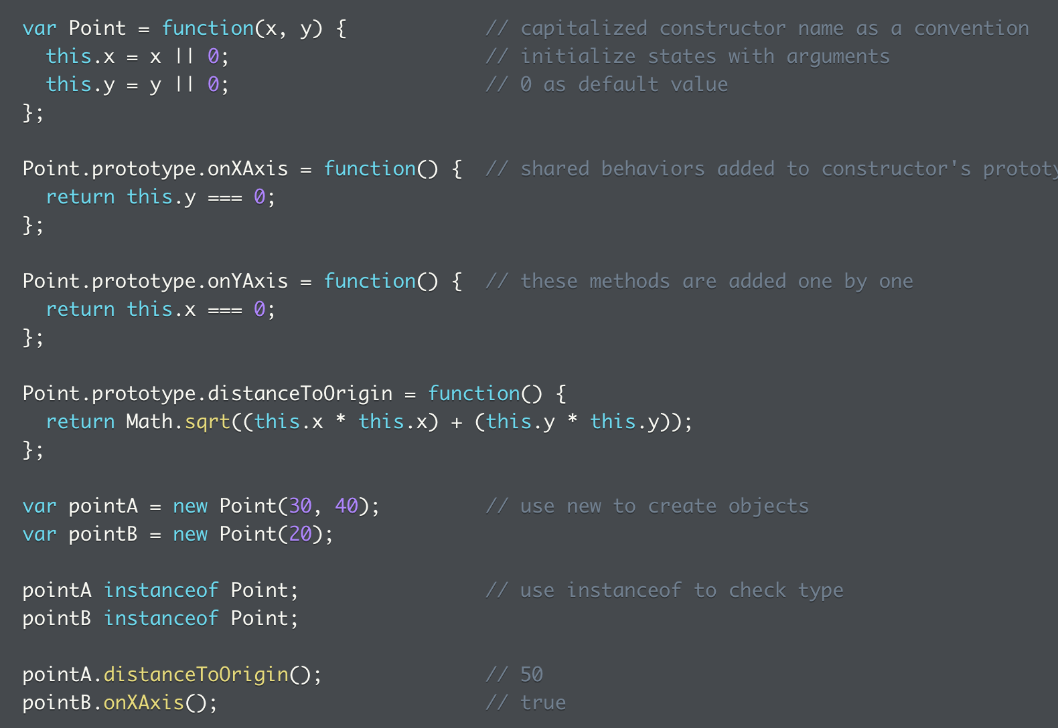
Pseudo-classical pattern
This is a combo of the constructor pattern and prototype pattern
Use constructor to set object states, put shared methods on constructor function’s prototyped
First set the object as a constructor by capitalizing the name
Then initialize states
Add shared behaviours to the object prototype chain
How to create constructors that inherit features from parent classes
https://developer.mozilla.org/en-US/docs/Learn/JavaScript/Objects/Inheritance

Slide 40
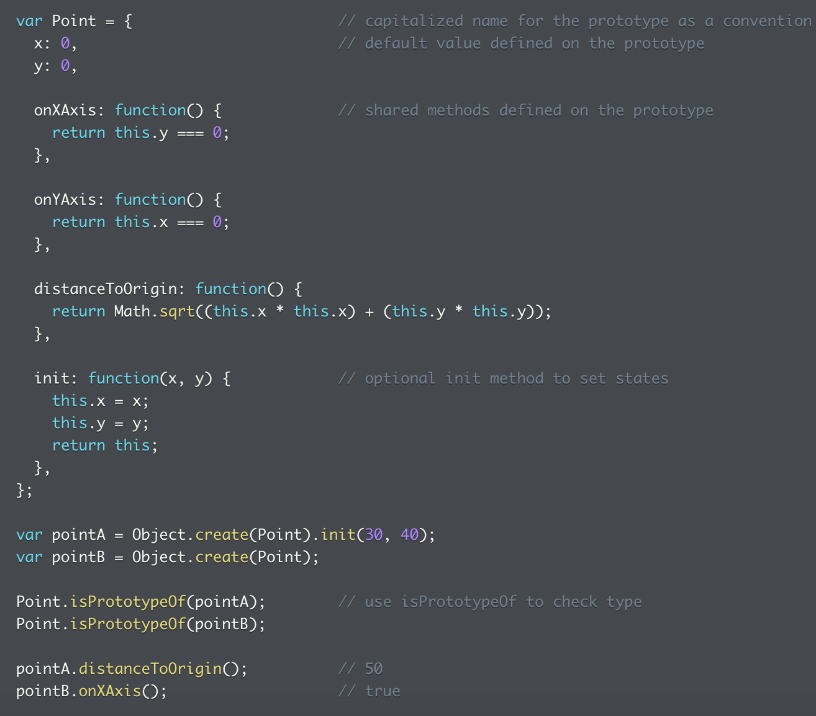
OLOO
When not pretending to be a class-oriented language, it embraces its prototype based object model
With OLOO, define shared behaviours on a prototype object, then use Object.create to create objects that delegate directly from object
No using constructors and their prototype properties
Process
Define default values on prototype
Shared methods defined on prototype
Optional init method to set states

Slide 41
Additional reading comparing two approaches
https://john-dugan.com/object-oriented-javascript-pattern-comparison/
https://medium.com/launch-school/javascript-design-patterns-building-a-mental-model-68c2d4356538
https://medium.com/@severinperez/javascript-weekly-fundamental-object-design-patterns-31453f68427f

Slide 42
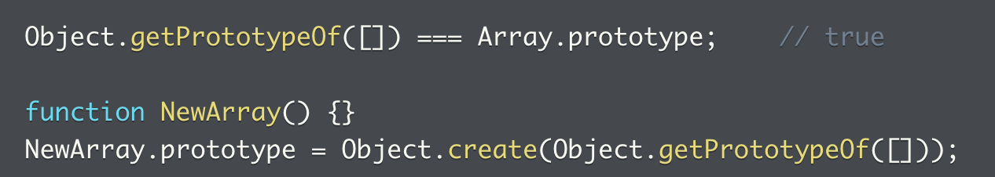
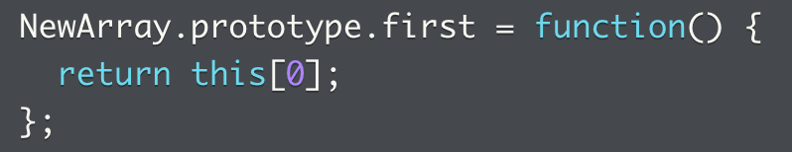
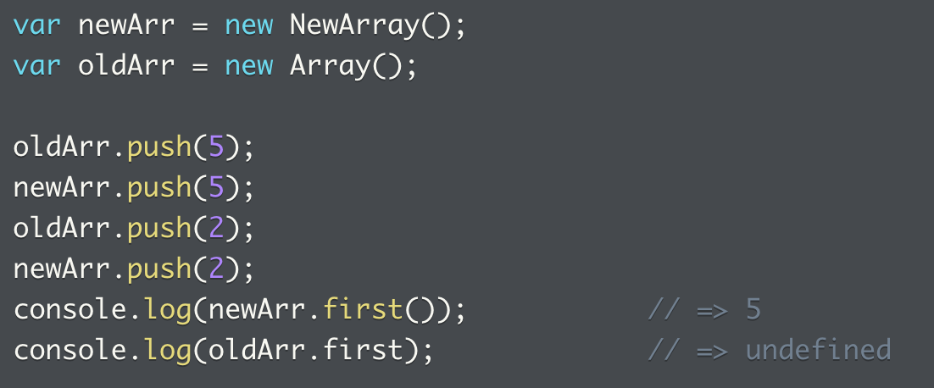
More Methods on the Object Constructor
There are a few more methods on the Object constructor:
https://developer.mozilla.org/en-US/docs/Web/JavaScript/Reference/Global_Objects/Object
Object.create, Object.getPrototypeOf
Note the empty array is an object whose prototype object is the Array.prototype object
We can create a function and use Object.create to have the NewArray.prototype object inherit from Array.prototype

Slide 43
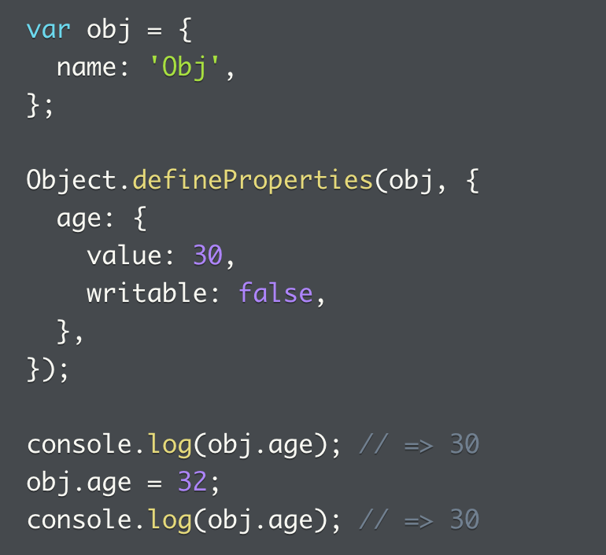
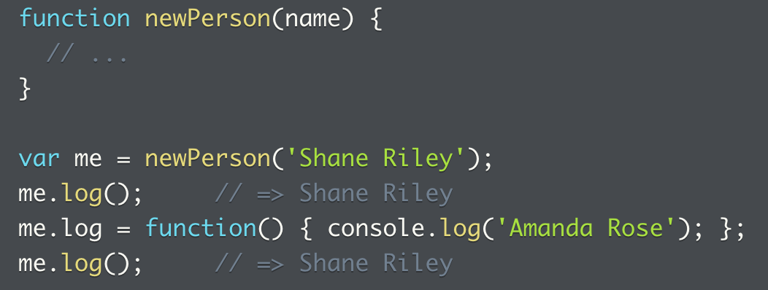
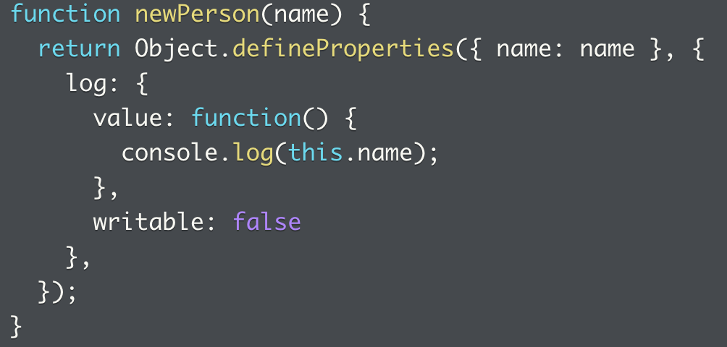
More methods on Object
Object.defineProperties
Provide properties and values and set whether each property can be changed or not
Create property on object that’s read-only
Can create function that constructs new object with log method that’s read only

Slide 44
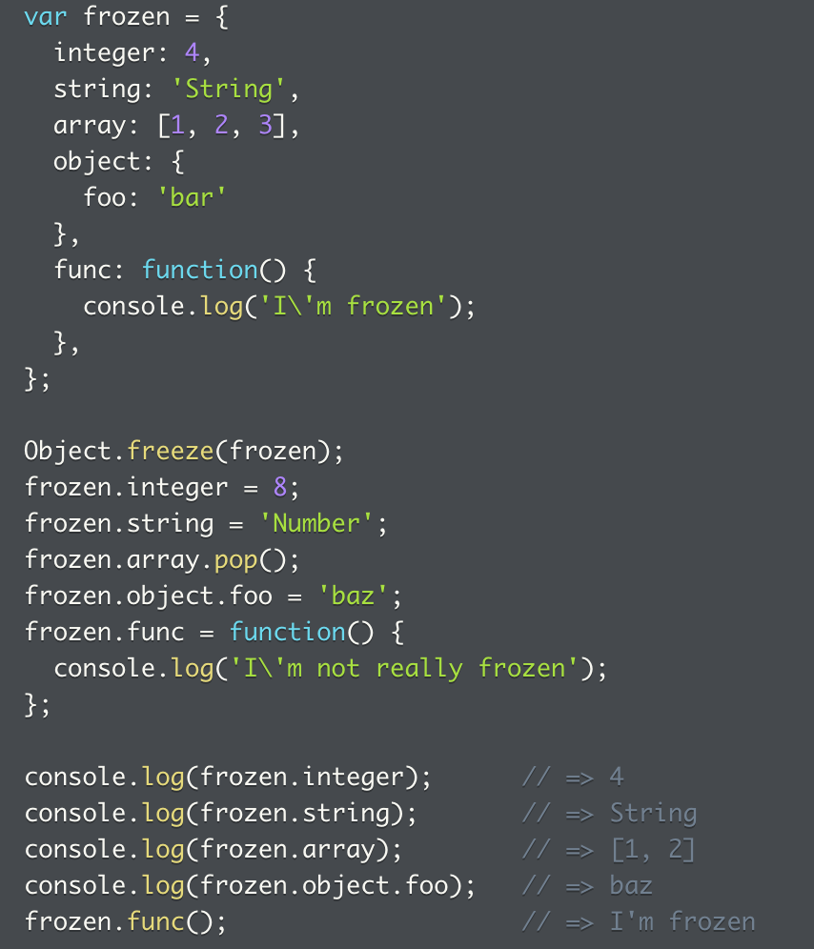
More methods on the Object (3)
Object.freeze
If the object should have properties that are all immutable, use this to prevent any change about an object
Note for property values that are objects, references to objects are frozen
But the frozen references can still be used to mutate the objects
As a result, all primitive values can’t be mutated, but arrays and objects can
But functions are frozen

Slide 45
Doug Crockford lecture on JS
https://www.youtube.com/watch?v=hQVTIJBZook&t=22m

Slide 46
Object Creation Patterns - Ancestors

